Slide 1

Magnons
in Ferromagnets
Julian Beisch
Konstanz, 17.12.2024

Slide 2
Motivation
Current computing
Electronics
Information by moving electrons (charge)
But they scatter Joule heating

Slide 3
Motivation
Current computing
Electronics
Information by moving electrons (charge)
But they scatter Joule heating
Another property of electrons: Spin
Spintronics
Make currents with spins, but how ?
Caveat
Spins depicted as arrows is just a semi-classical approximation of an otherwise quantum mechanical expectation distribution

Slide 4
Classification
Bound e⁻
Quasi-free e⁻
Scope
Dia
Lamor diamagnetism
Landau
diamagnetism
Para
Langevin paramagnetism
Pauli
paramagnetism
IM
Cooperative magnetism
Band ferromagnetism
Notes:
Gucken uns gleich wechselwirkenden Magnetismus an, vorher guckt ihr euch aber die Interaktion eines Spins mit einem Feld an

Slide 5
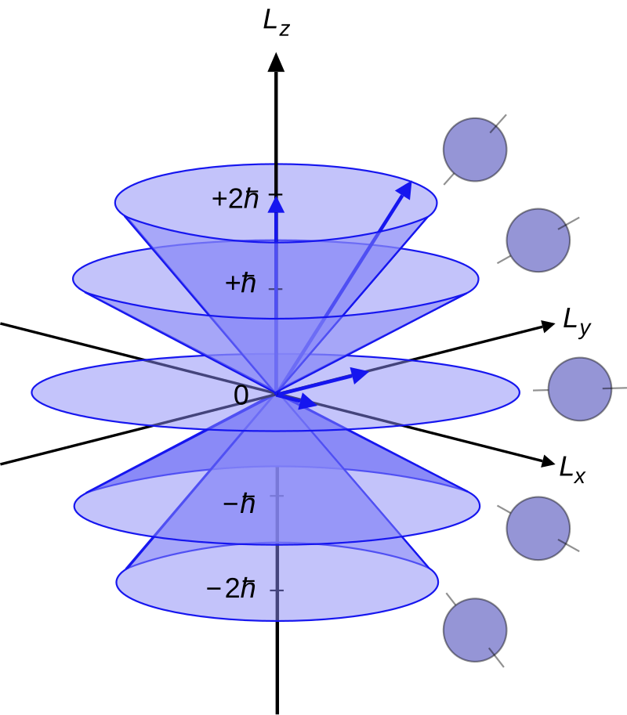

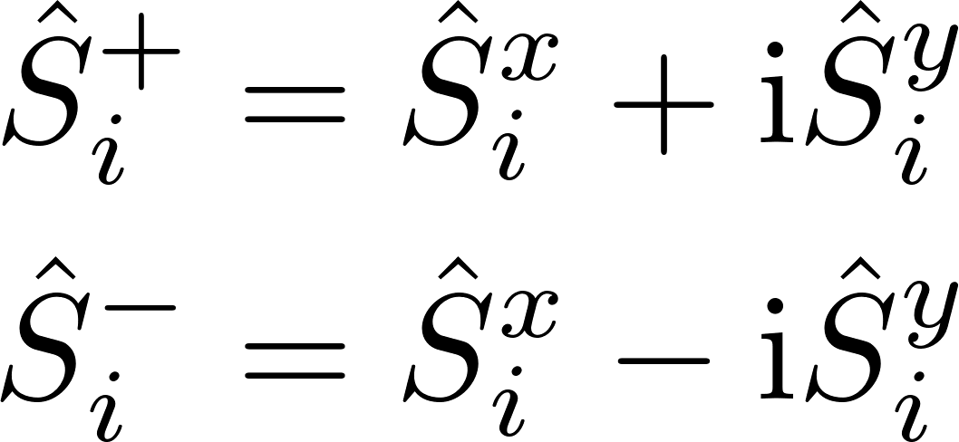
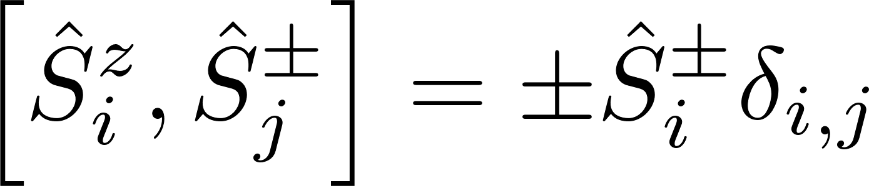
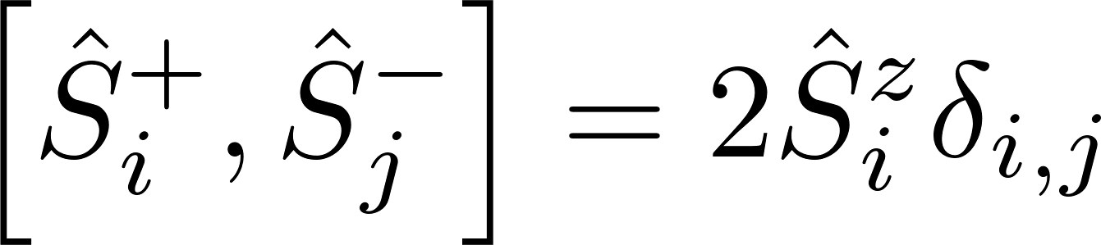
Spin-operators
Spin-operators
Wikipedia.com
Notes:
We repeat them here since they are quite important for this talk
They fulfill the angular momentum algebra

Slide 6
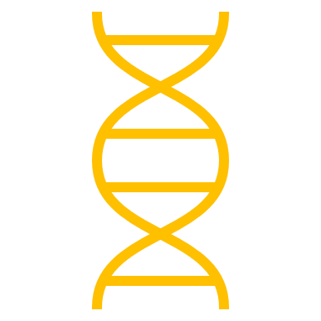
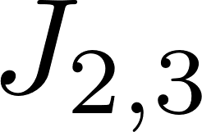




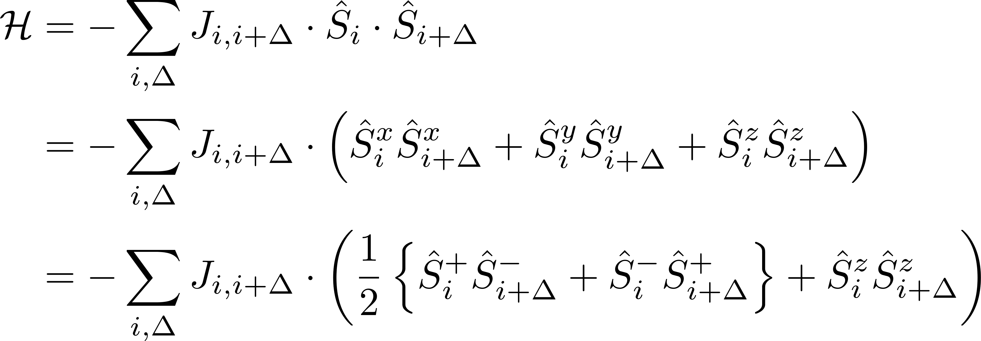
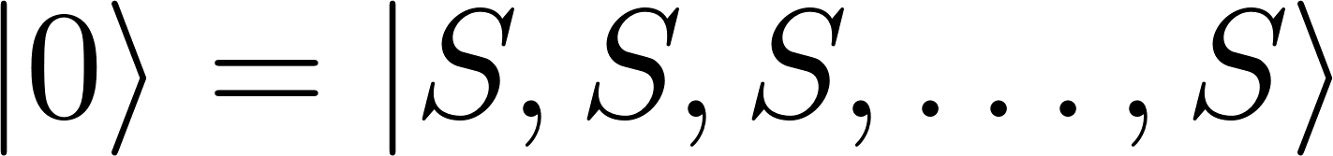
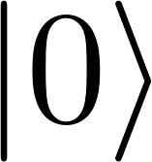
Heisenberg Theory of Ferromagnetism
Groundstate
W.Heisenberg Z.Physik 49, 619-636, (1928)

Slide 7
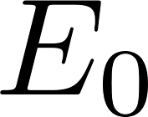
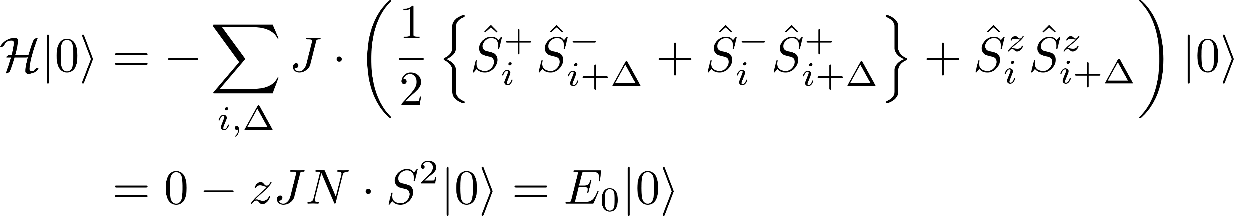
Heisenberg Theory of Ferromagnetism
Groundstate
An eigenstate, with the eigenenergy
W.Heisenberg Z.Physik 49, 619-636, (1928)
Notes:
½ due to double counting
For a chain like depicted with only nearest neighbour interaction we get a coordination number of z = 2 hence the factor cancel

Slide 8
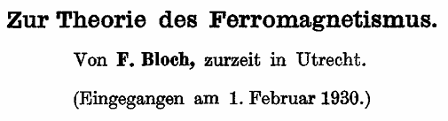
Bloch Theory of Ferromagnetism
Excitations
Groundstate
How do excitations of this state look like?
F.Bloch. Z.Physik 61, 206-219 (1930)
Notes:
The same question was asked by Felix Block
He found several low-lying excited states
We will now obtain the same result as him, but we will use a more modern path

Slide 9
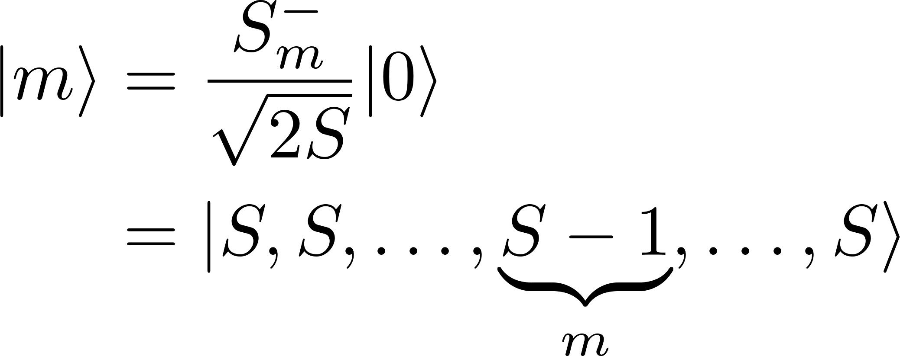
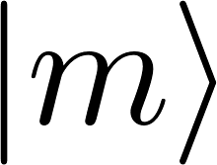
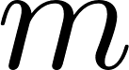
Bloch Theory of Ferromagnetism
Excitations
His approach was to consider one
flipped spin
Not an eigenstate anymore
Notes:
Flipped of course only if S = ½ but otherwise tilted
Not an eigenstate anymore, which we can quickly calculate

Slide 10
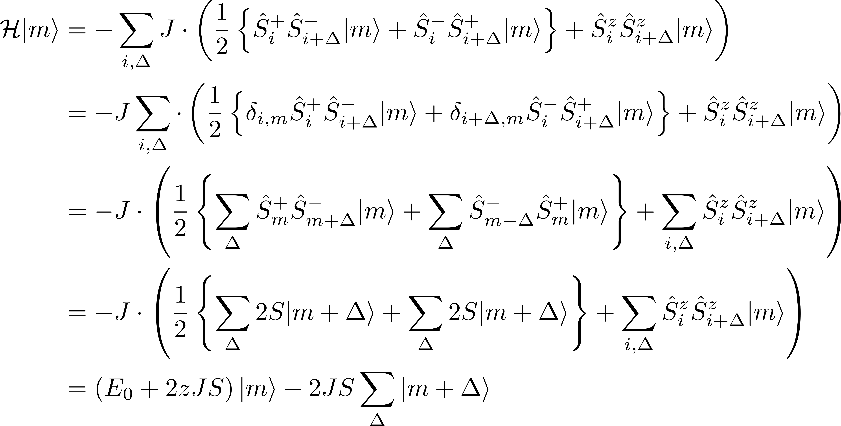
Bloch Theory of Ferromagnetism
Excitations
His approach was to consider one
flipped spin
Not an eigenstate anymore
E.Rastelli, Statistical Mechanics of Magnetic Excitations (2013)
Notes:
2S because of eigenvalues of the spin operators
We can go from m – delta to m + delta, since we assume that delta is symmetric around zero
Same as in enrico rastelli

Slide 11
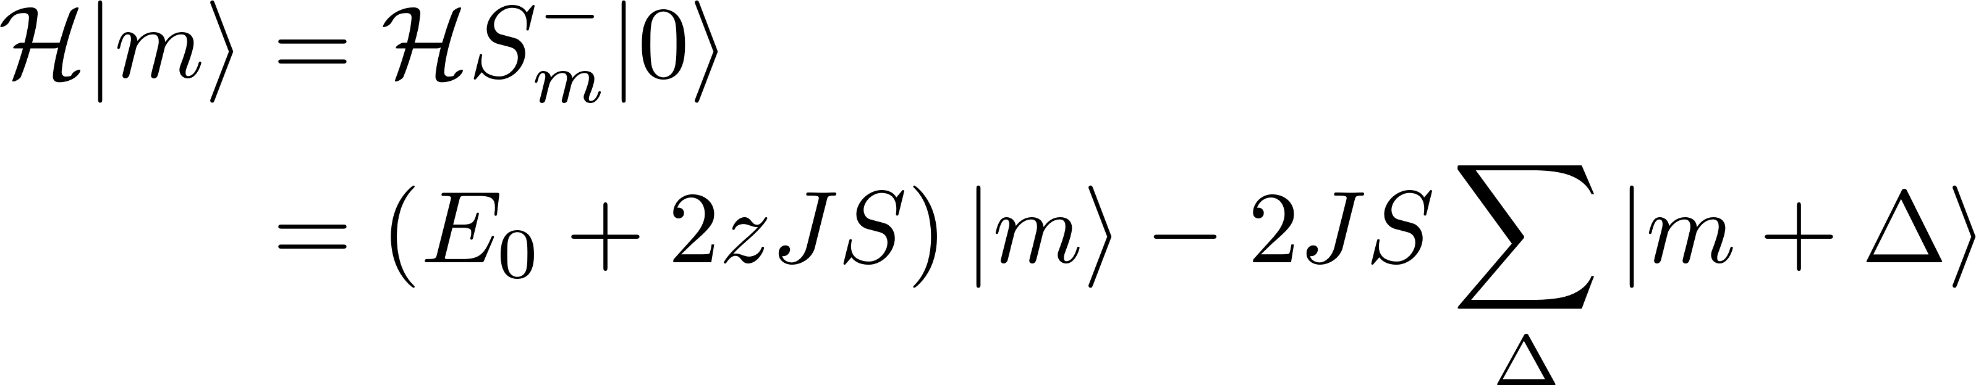
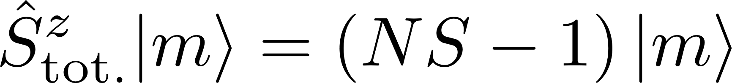
Bloch Theory of Ferromagnetism
Search for eigenstates
Not an eigenstate anymore.
The total magnetization was reduced by 1!
Notes:
Indepent of the fact that the picture is for s=1/2

Slide 12
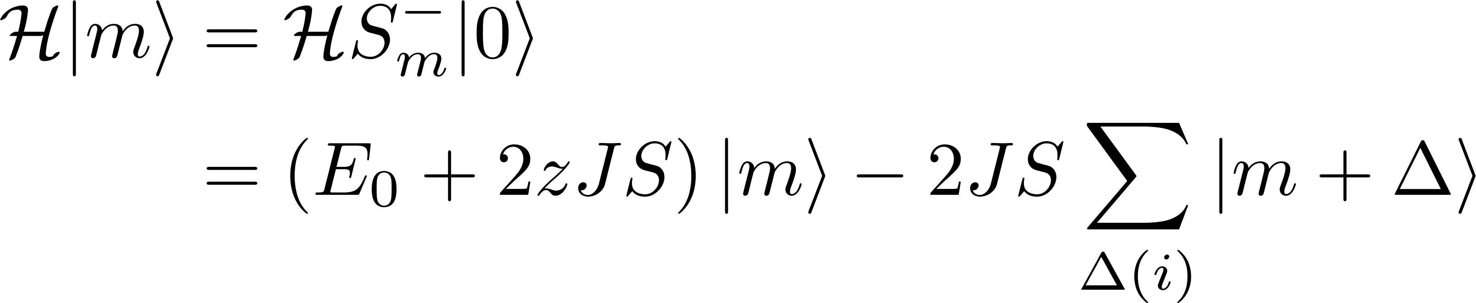
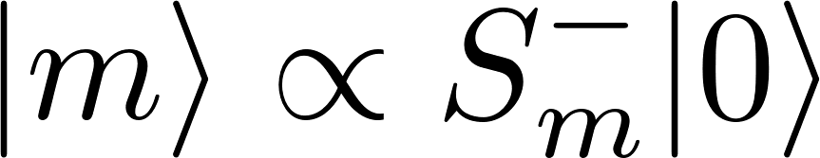
Bloch Theory of Ferromagnetism
Search for eigenstates
Not an eigenstate anymore.
The total magnetization was reduced by 1!
Hence we can guess an eigenstate
Notes:
But if we can see a linear combination of states could be what we want.
WE want the first excitation to be a eigenstate with a higher energy and a reduced magnetization.
This is a bit similiar to a coherent state, but also something we already saw in several lectures.

Slide 13
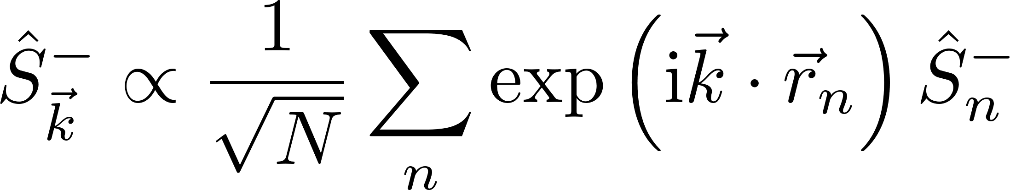
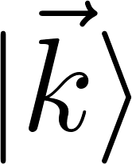
Bloch Theory of Ferromagnetism
Search for eigenstates
Not an eigenstate anymore.
The total magnetization was reduced by 1!
Hence we can guess an eigenstate
Notes:
But if we can see a linear combination of states could be what we want.
WE want the first excitation to be a eigenstate with a higher energy and a reduced magnetization.
This is a bit similiar to a coherent state, but also something we already saw in several lectures.

Slide 14
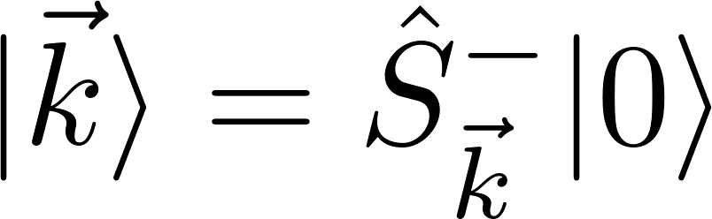
Bloch Theory of Ferromagnetism
Search for eigenstates
Not an eigenstate anymore.
The total magnetization was reduced by 1!
Hence we can guess an eigenstate
Notes:
But if we can see a linear combination of states could be what we want.
WE want the first excitation to be a eigenstate with a higher energy and a reduced magnetization.
This is a bit similiar to a coherent state, but also something we already saw in several lectures.

Slide 15
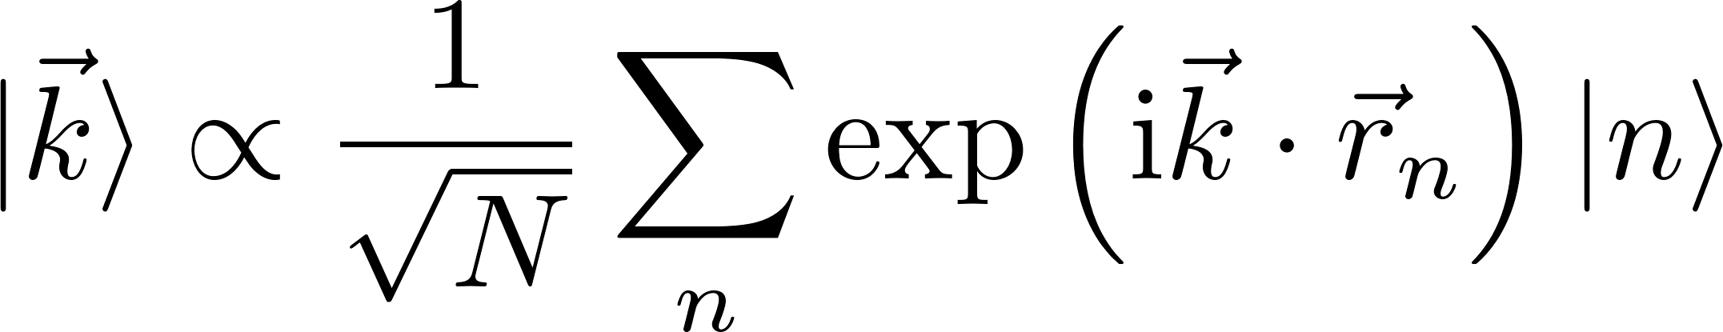
Bloch Theory of Ferromagnetism
Search for eigenstates
Not an eigenstate anymore.
The total magnetization was reduced by 1!
Hence we can guess an eigenstate
Notes:
But if we can see a linear combination of states could be what we want.
WE want the first excitation to be a eigenstate with a higher energy and a reduced magnetization.
This is a bit similiar to a coherent state, but also something we already saw in several lectures.

Slide 16
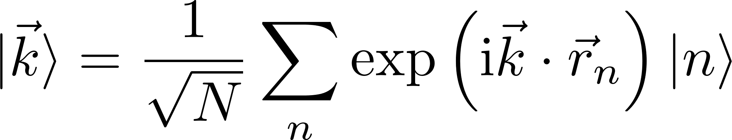
Bloch Theory of Ferromagnetism
Search for eigenstates
Not an eigenstate anymore.
The total magnetization was reduced by 1!
Hence we can guess an eigenstate
Notes:
|n> means that the spin at site n is flipped/tilted
Thus we have a superposition of where each titled spin is
|k> states are orthonormal

Slide 17
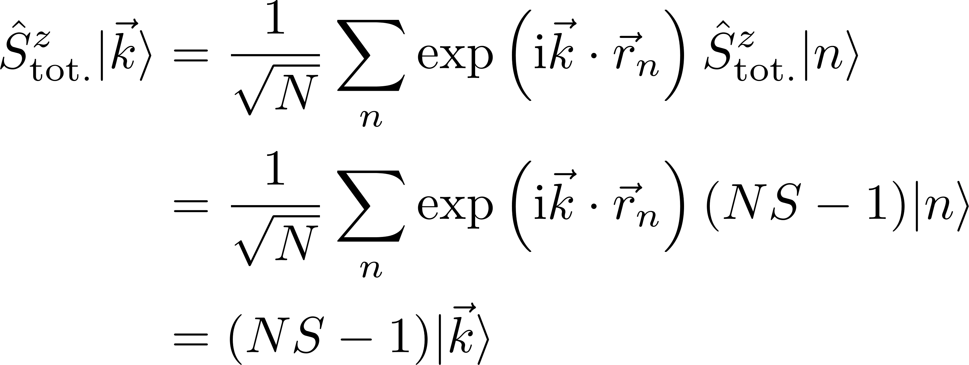
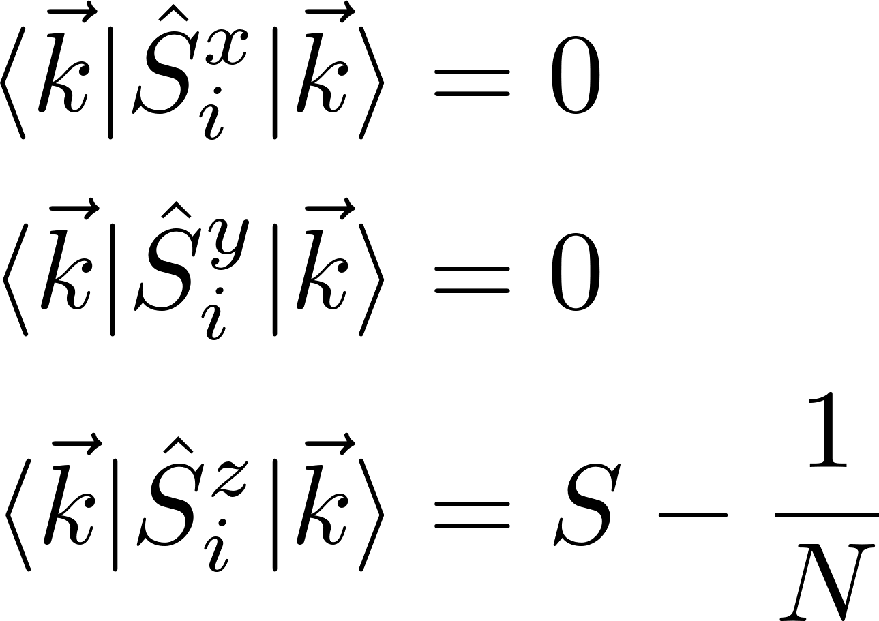
Bloch Theory of Ferromagnetism
Properties of the eigenstates
The total magnetization is reduced
As well as an increase in energy
But the average x and y components are still zero?
Notes:
The total magnetization in z is reduced, but the average x and y component are still zero? How can that be?
We can also see here that the z-compontne for a site I seems to be only reduced by 1/N instead of 1
The average in zero is correct since the k state are orthogonal, and we do not break heisenbergs uncertainty relation since this is just the average, whilst the variance is not equal zero

Slide 18
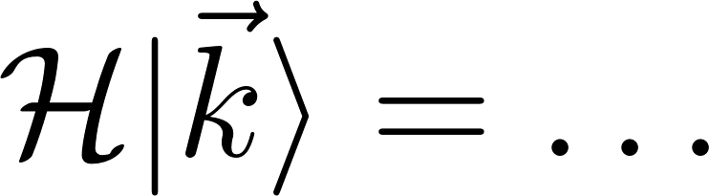
Bloch Theory of Ferromagnetism
Properties of the eigenstates
The total magnetization is reduced
As well as an increase in energy

Slide 19
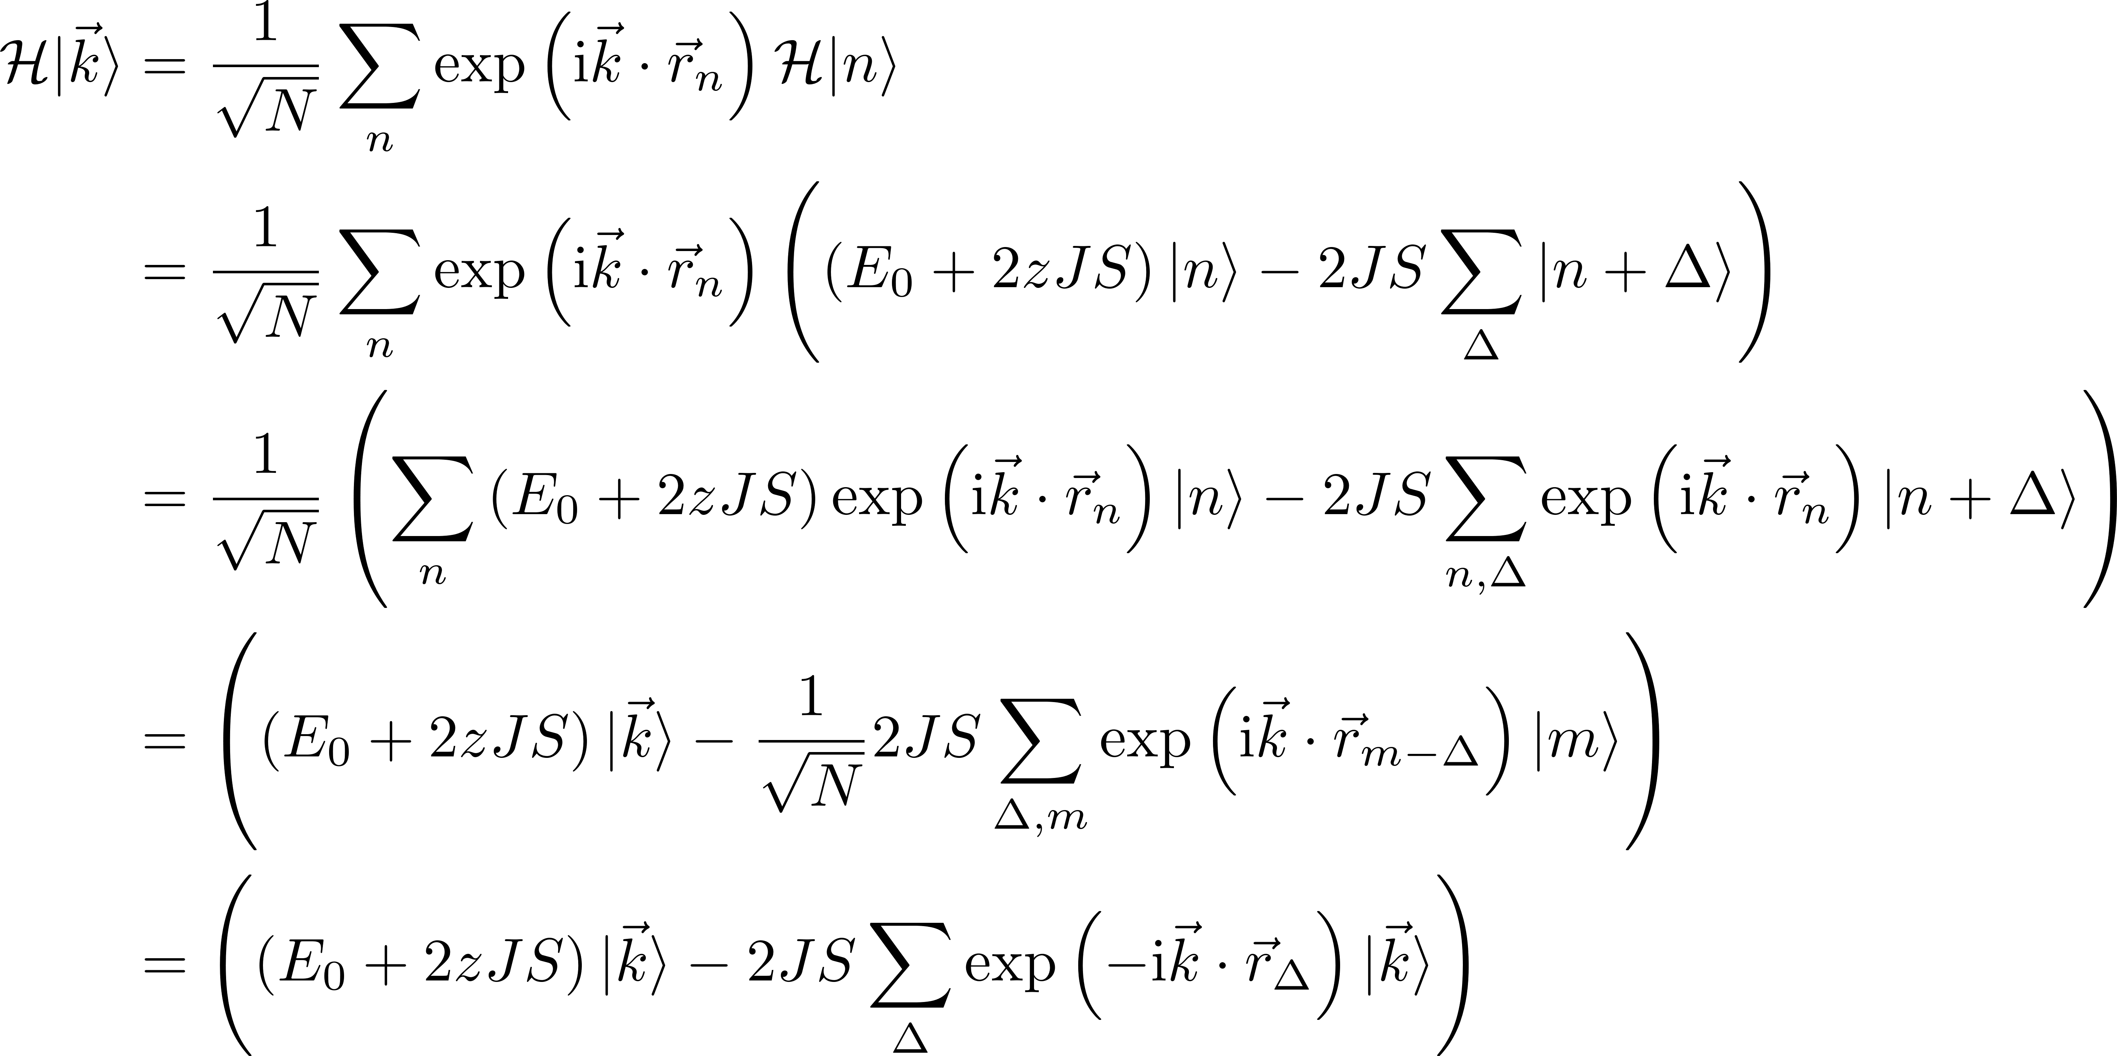
Ferromagnetic Dispersion relation

Slide 20
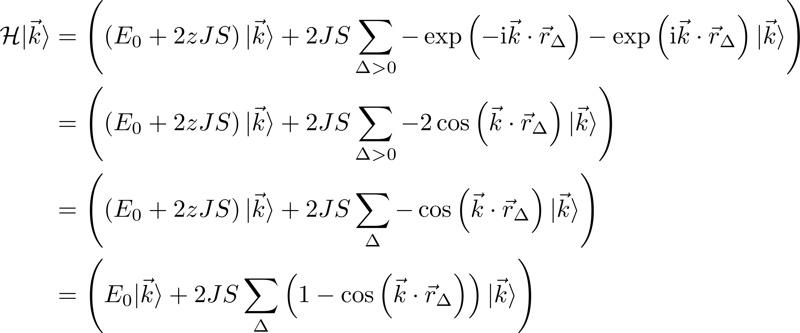
Ferromagnetic Dispersion Relation
Properties of the eigenstates
Notes:
The z hides under the sum, because the sum over delta runs over all interactions hence sum 1 = z
The sum for the linear chain of spins

Slide 21
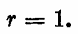
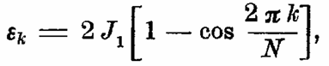
Ferromagnetic Dispersion Relation
Properties of the eigenstates
Same result with semiclassical
calculation
F.Bloch. Z.Physik 61, 206-219 (1930)
Notes:
The z hides under the sum, because the sum over delta runs over all interactions hence sum 1 = z
The sum for the linear chain of spins

Slide 22
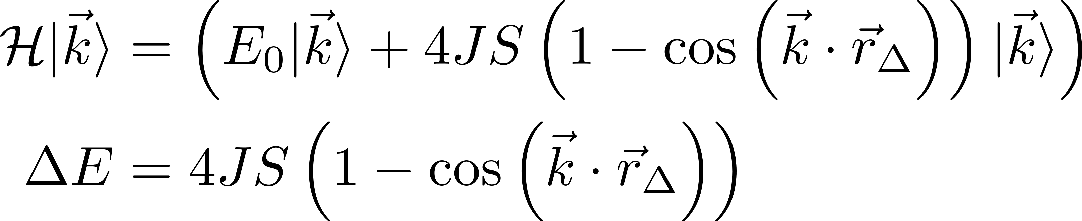
Ferromagnetic Dispersion Relation
Properties of the eigenstates
Same result with semiclassical
calculation
F.Bloch. Z.Physik 61, 206-219 (1930)
For a linear chain with NN
S.Blundell, Magnetism in Condensed matter (2000)
Notes:
The z hides under the sum, because the sum over delta runs over all interactions hence sum 1 = z
The sum for the linear chain of spins

Slide 23
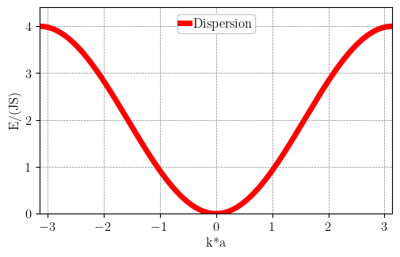
Ferromagnetic Dispersion Relation
Properties of the eigenstates
F.Bloch. Z.Physik 61, 206-219 (1930)

Slide 24
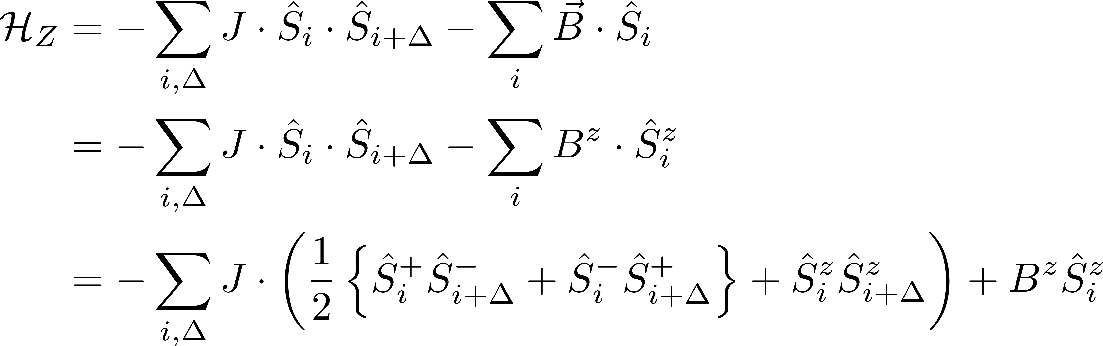
Ferromagnetic Dispersion Relation with a Magnetic Field
Addition of Zeeman term
Notes:
Since we have no anisotropy or anything else that breaks the isotropic hamilotoain we can always chose the field to be along the quantisation axis
Anisotropy term would like (write on blackboard maybe)

Slide 25
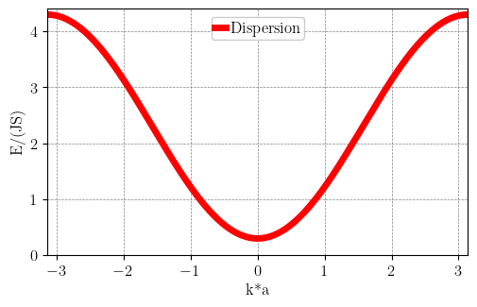
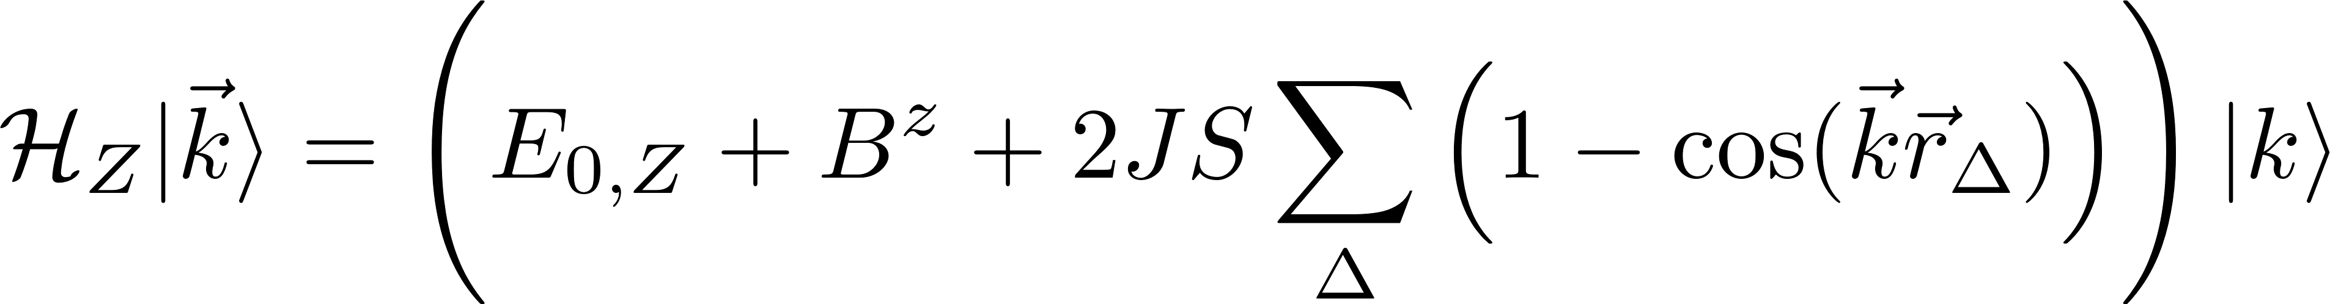
Ferromagnetic Dispersion Relation with a Magnetic Field
Addition of Zeeman term
Notes:
Since we have no anisotropy or anything else that breaks the isotropic hamilotoain we can always chose the field to be along the quantisation axis
Anisotropy term would like (write on blackboard maybe)

Slide 26
Recap
First excited state
Delocalization of a “flipped” spin over all sites
Notes:
Delocalization of a “flipped” spin over all sites
Collective excitation of the system
The probability to find the excitation at any site m is 1/N
And how do we name such a magnetic boson ? We combine the names to magnon

Slide 27
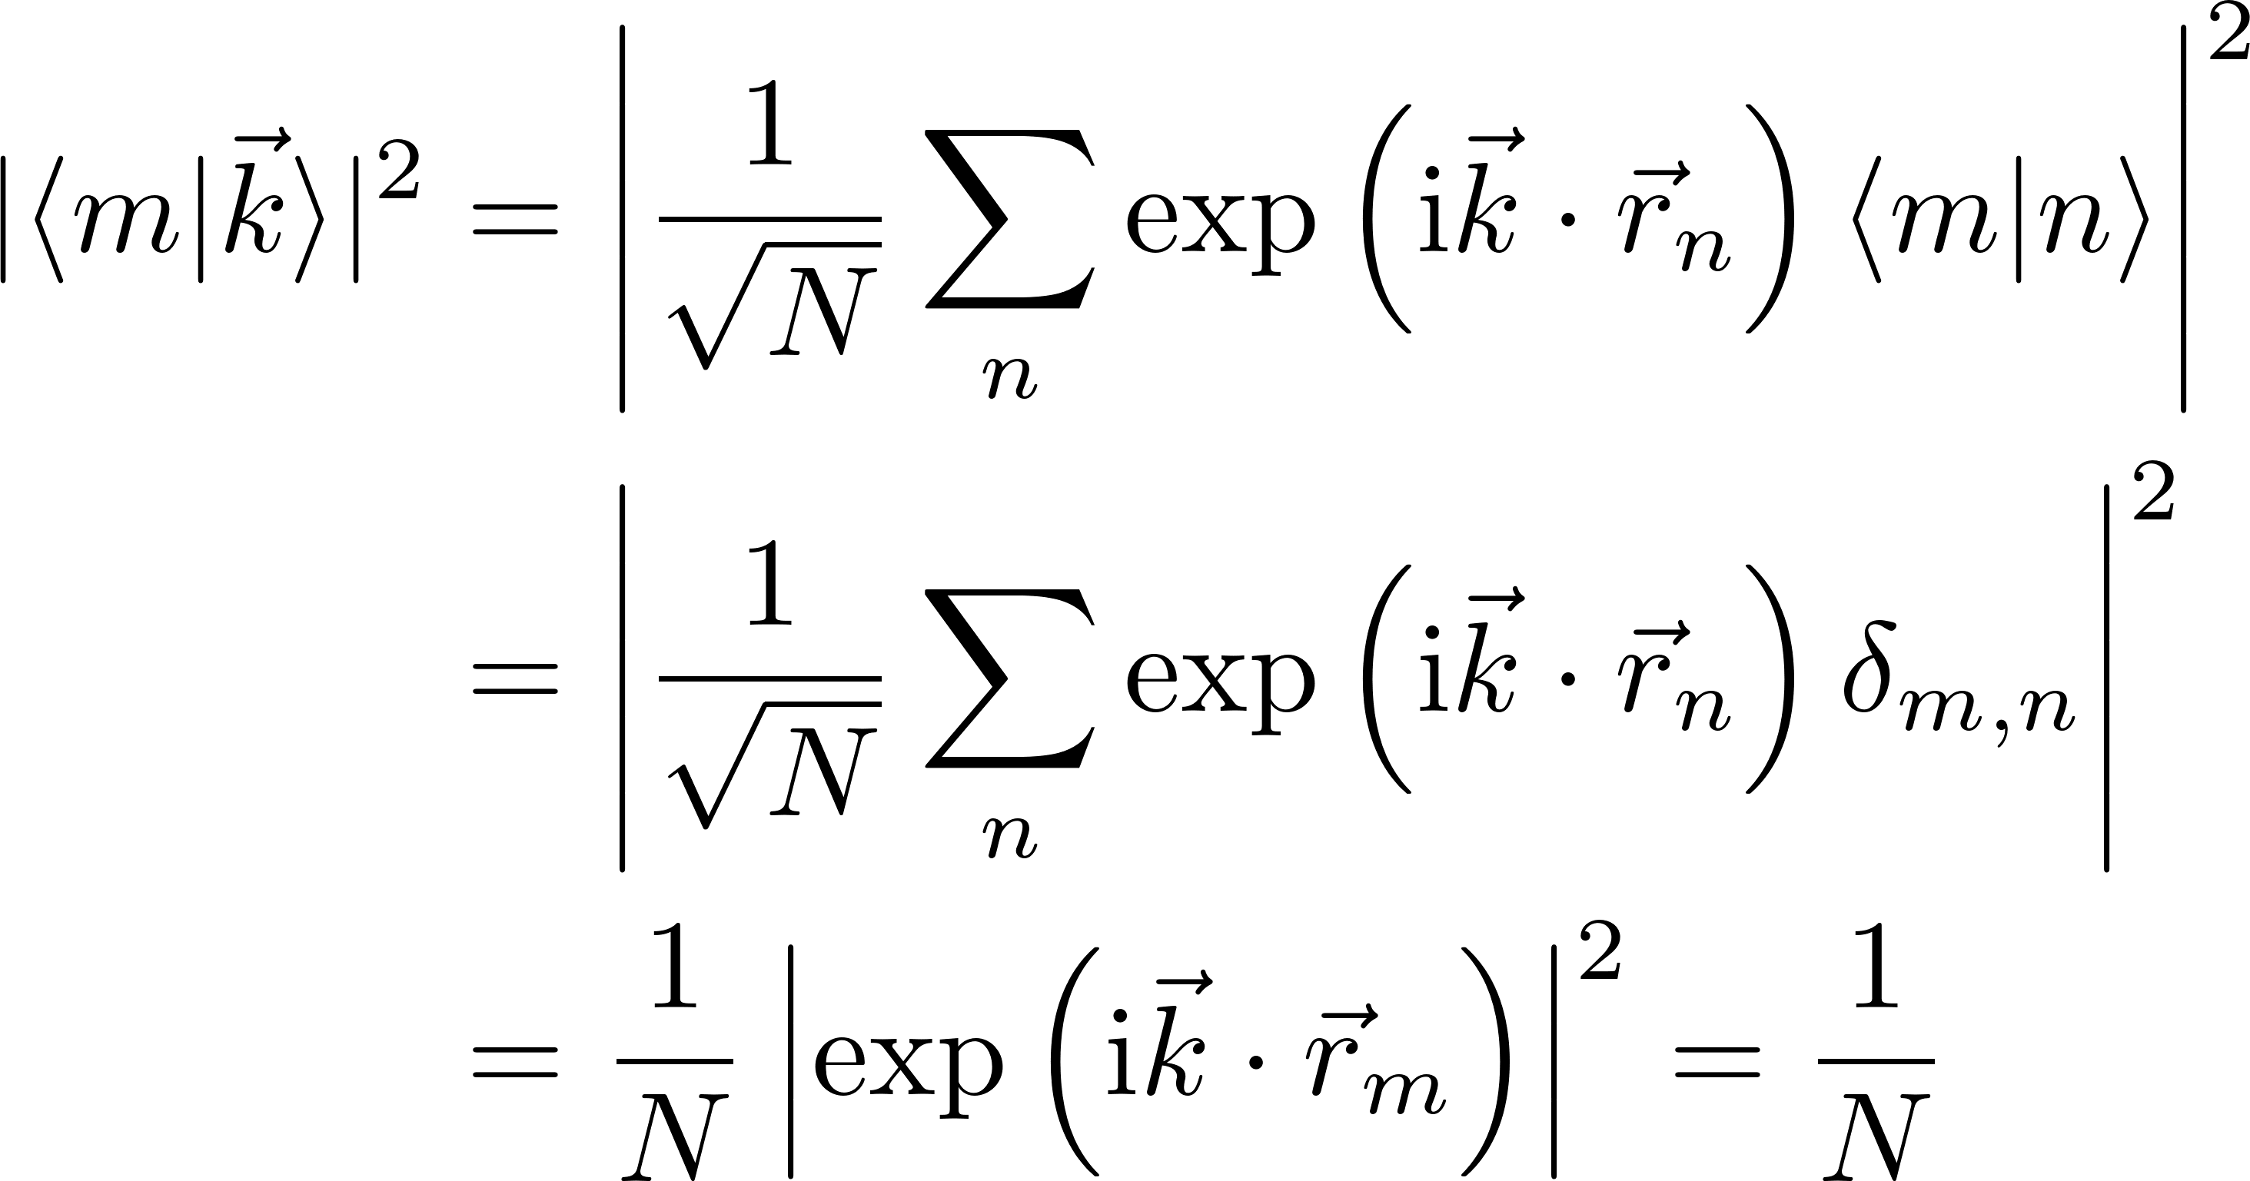
Recap
First excited state
Delocalization of a “flipped” spin over all sites
Collective excitation
Notes:
Delocalization of a “flipped” spin over all sites
Collective excitation of the system
The probability to find the excitation at any site m is 1/N
And how do we name such a magnetic boson ? We combine the names to magnon

Slide 28
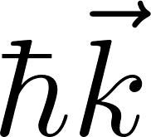
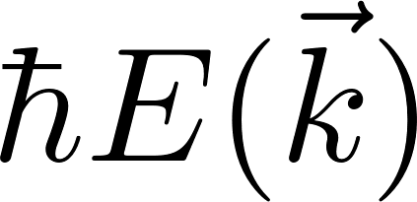
Recap
First excited state
Delocalization of a “flipped” spin over all sites
Collective excitation
By comparison to phonons:
-Well defined momentum
-Energy
Quasiparticle
Notes:
Delocalization of a “flipped” spin over all sites
Collective excitation of the system
The probability to find the excitation at any site m is 1/N
And how do we name such a magnetic boson ? We combine the names to magnon

Slide 29
Recap
First excited state
Delocalization of a “flipped” spin over all sites
Collective excitation
By comparison to phonons:
-Well defined momentum
-Energy
Reduces magnetization by 1 Integer spin Boson
Quasiparticle
Notes:
Delocalization of a “flipped” spin over all sites
Collective excitation of the system
The probability to find the excitation at any site m is 1/N
And how do we name such a magnetic boson ? We combine the names to magnon

Slide 30
Recap
First excited state
Delocalization of a “flipped” spin over all sites
Collective excitation
By comparison to phonons:
-Well defined momentum
-Energy
Reduces magnetization by 1 Integer spin Boson
Quasiparticle
Magnon
Notes:
Delocalization of a “flipped” spin over all sites
Collective excitation of the system
The probability to find the excitation at any site m is 1/N
And how do we name such a magnetic boson ? We combine the names to magnon

Slide 31
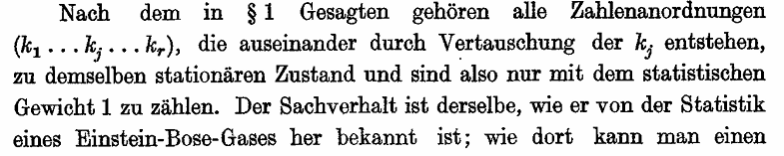
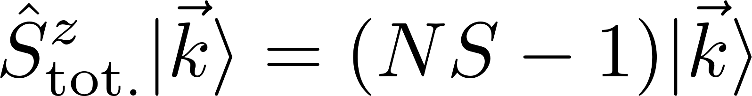
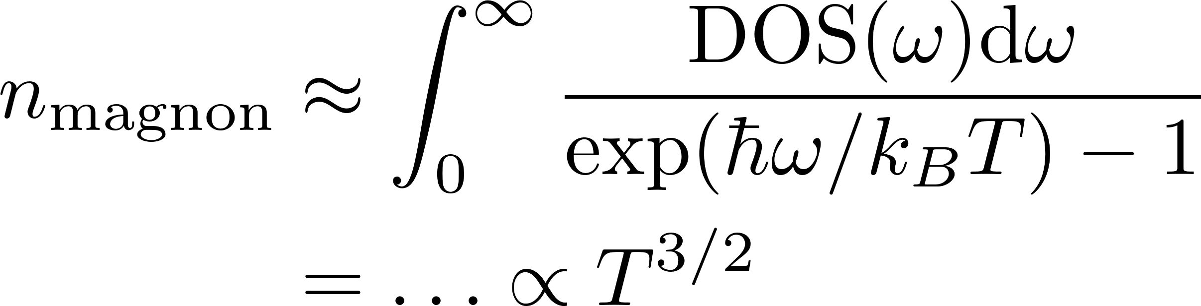
Magnons as Bosons
Thermodynamical treatment
Since it is a boson it must fulfill the Bose-Einstein statistic
F.Bloch. Z.Physik 61, 206-219 (1930)
Bose factor
Number of magnons @ T
Notes:
The more magnons we have the more the magnetsiatioin is reduced
The density of states can be estimated from the dispersion relation
This has been reproduces by many experiments
Fun fact for an isotropic Heisenberg ferromagnet in 1 or 2 d the intergral diverges for all T>0, hence infinite number of magnons, hence sponatanoues ferromagnetism is not possible (Mermin-Wagner-Berezinnskii-theorem) does work with non

Slide 32
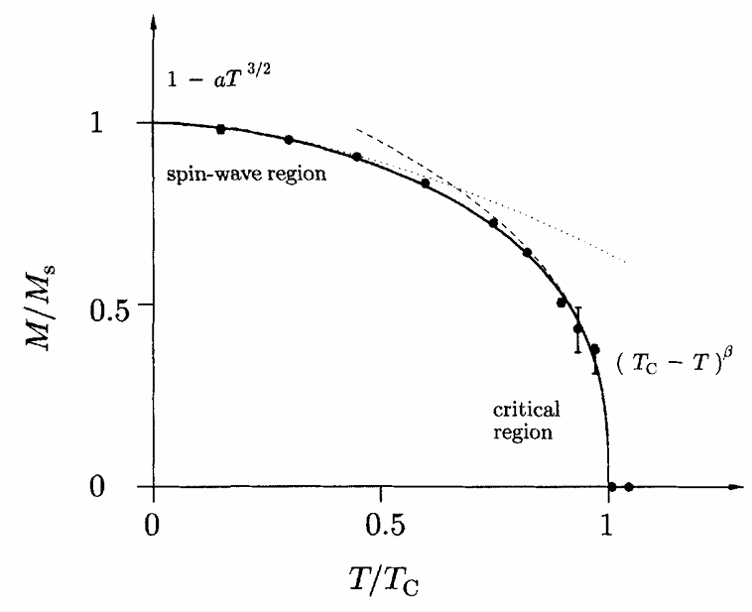
Magnons as Bosons
Thermodynamical treatment
Since it is a boson it must fulfill the Bose-Einstein-statistic
F.Bloch. Z.Physik 61, 206-219 (1930)
Bose factor
Number of magnons @ T
S.Blundell, Magnetism in Condensed matter (2000)
Notes:
The more magnons we have the more the magnetsiatioin is reduced
The density of states can be estimated from the dispersion relation
This has been reproduces by many experiments
Fun fact for an isotropic Heisenberg ferromagnet in 1 or 2 d the intergral diverges for all T>0, hence infinite number of magnons, hence sponatanoues ferromagnetism is not possible (Mermin-Wagner-Berezinnskii-theorem) does work with non

Slide 33
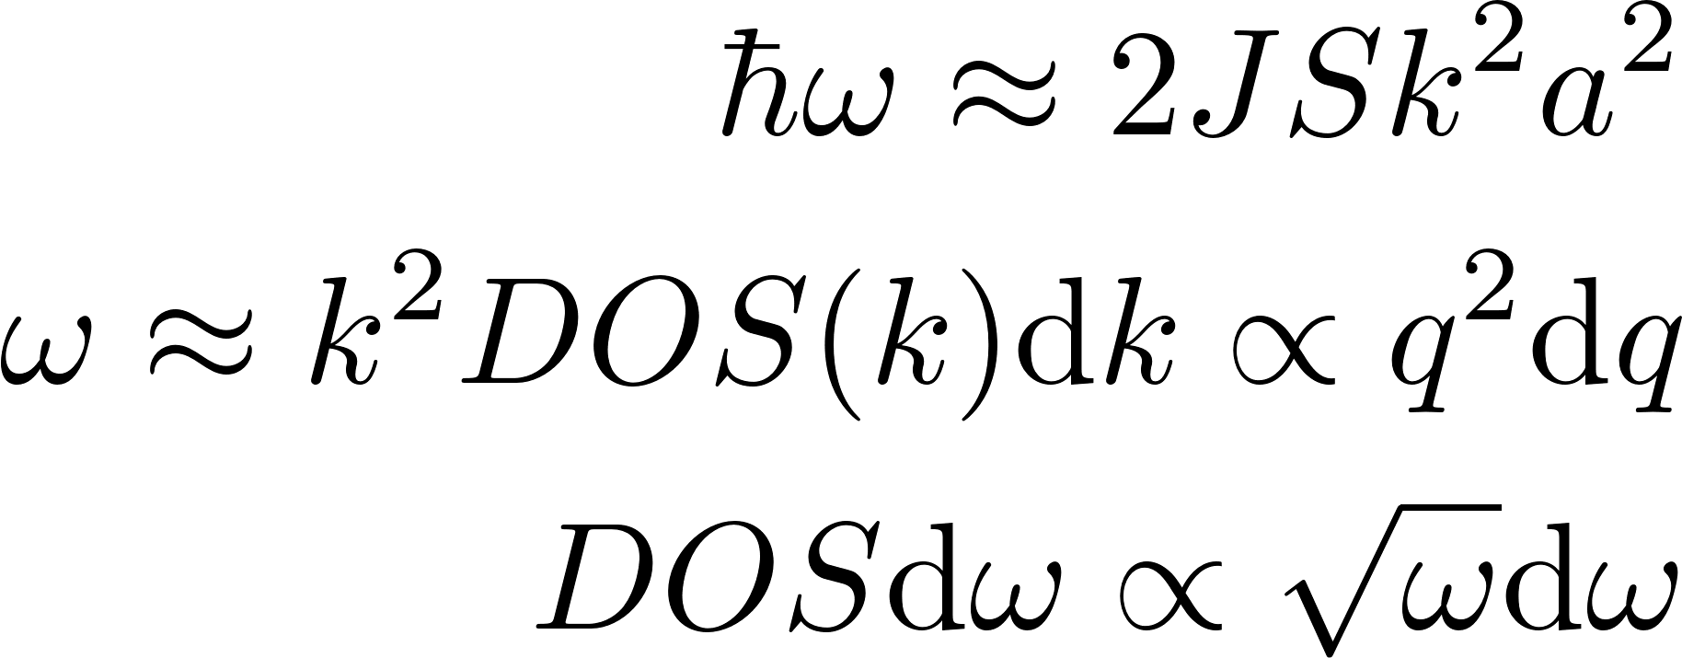
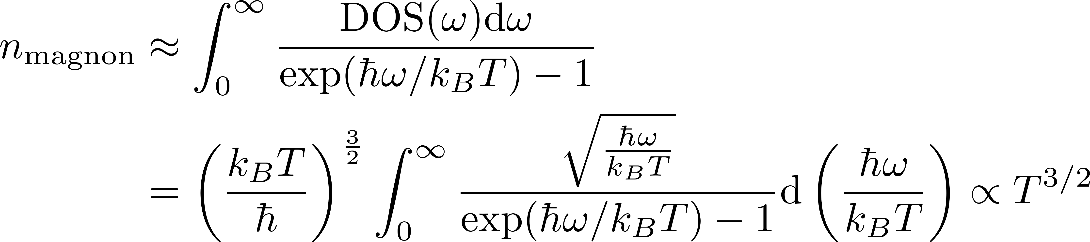
Magnons as Bosons
Thermodynamical treatment
Since it is a boson it must fulfill Bose-Einstein-statistic
Each thermally excited magnon reduces the magnetization by 1
Bose factor
Number of magnons @ T
S.Blundell, Magnetism in Condensed matter (2000)
Notes:
The more magnons we have the more the magnetsiatioin is reduced
The density of states can be estimated from the dispersion relation
This has been reproduces by many experiments
Fun fact for an isotropic Heisenberg ferromagnet in 1 or 2 d the intergral diverges for all T>0, hence infinite number of magnons, hence sponatanoues ferromagnetism is not possible (Mermin-Wagner-Berezinnskii-theorem) does work with non

Slide 34
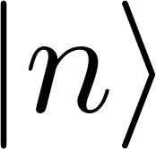
Spin-Boson Transformation
How to describe magnons
The spin operators are not bosonic
Magnons are bosonic
Alternative approach:
LLG (analytically or numerically)
Or Schwinger representation
Or Dyson–Maleev representation
Conditions
The transformation needs to be Hermitian, raising and lowering operators written as creation and annihilation boson operators need to be Hermitian conjugate of each other
The transformation must be unitary to preserve the commutation relations between the spin operators.
Must satisfy the equality between the matrix elements of the spin operators on |0> and the bosons on |n>
E.Rastelli, Statistical Mechanics of Magnetic Excitations (2013)
Notes:
Search transformation that writes the ang. Moment. Operators as bosonic creation and annihilation operators
Or Dyson–Maleev representation breaks (i)

Slide 35
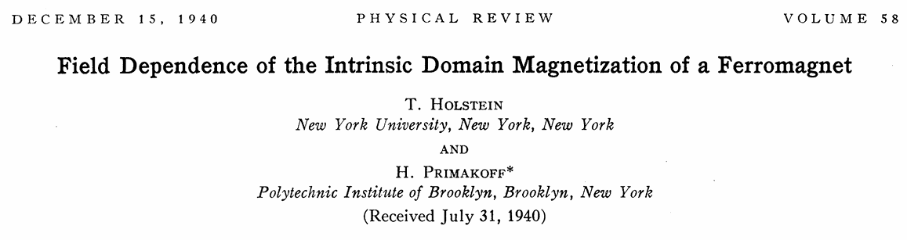
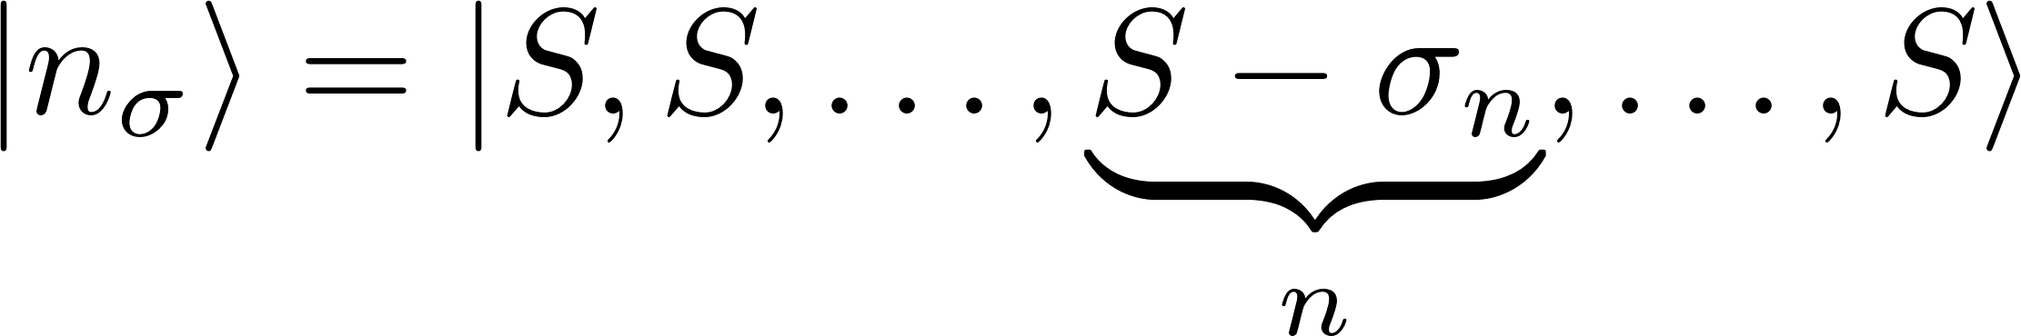
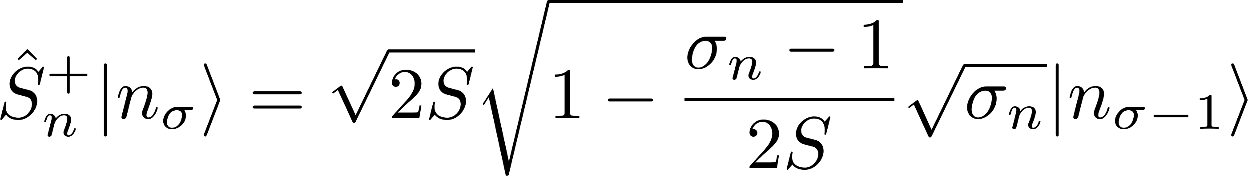

A Spin-Boson Transformation
Define higher magnon states
Notes:
We do not use the k state yet, since if they are equal here we can later use the determination of the k state (same as before) and they should still be identical (thats how they do it in thier paper

Slide 36


A Spin-Boson Transformation
Define higher magnon states
Only for

Slide 37


A Spin-Boson Transformation
Consider the states to be like 2nd quantized number states
Compare the “eigenvalues”
Only for

Slide 38

A Spin-Boson Transformation
Consider the states to be like 2nd quantized number states
Compare the “eigenvalues”
x

Slide 39


A Spin-Boson Transformation
Consider the states to be like 2nd quantized number states
Compare the “eigenvalues”
x

Slide 40


The Holstein Primakoff Spin-Boson Transformation
Combined
T-Holstein, H.Primakoff PR 58, 1098, (1940)

Slide 41

T-Holstein, H.Primakoff PR 58, 1098, (1940)

Slide 42

The Holstein Primakoff Spin-Boson Transformation
Checking the conditions
Fulfilled
Does fulfill the commutation relations
Fulfilled by definition
for
E.Rastelli, Statistical Mechanics of Magnetic Excitations (2013)
T-Holstein, H.Primakoff PR 58, 1098, (1940)

Slide 43

Holstein-Primakoff(HP)

Slide 44



The Holstein Primakoff Spin-Boson Transformation
Applications
HP framework is a powerful method for calculating dispersions and higher order interactions
T-Holstein, H.Primakoff PR 58, 1098, (1940)
Journals.aps.org
Notes:
This condtion that we need is in order to not have complex operaors

Slide 45




Linearized Holstein-Primakoff
Sacrifices
Does not fulfill the boson commutation relations
Hence (ii) is violated
T-Holstein, H.Primakoff PR 58, 1098, (1940)
Linearized HP
Notes:
This one breaks condition ii, which was that the commutation relations cant be broken

Slide 46

Holstein-Primakoff
Simplified application
Only linear Spin-Wave theory using the linearized HP
T-Holstein, H.Primakoff PR 58, 1098, (1940)
Linearized HP
Notes:
Want to express the Hamiltonian with the bosonic operators

Slide 47

Holstein-Primakoff
Linearized HP
Rewrite the Hamiltonian
Time evolution of an operator:
Notes:
What can we do with this expression?
We can look at the time evolution of an operator

Slide 48

Holstein-Primakoff
Linearized HP
Rewrite the Hamiltonian
Time evolution of an operator:
Problem: Coupling between all sites! Practically unsolvable for real systems
Notes:
What can we do with this expression?
We can look at the time evolution of an operator

Slide 49


Holstein-Primakoff
The new Hamiltonian
Time evolution of an operator:
Going to Fourier-space
Lattice Fourier transformation
Problem: Coupling between all sites! Practically unsolvable for real systems

Slide 50

Holstein-Primakoff
The new Hamiltonian
Time evolution of an operator:
Going to Fourier-space
Lattice Fourier transformation
Time evolution:
Problem: Coupling between all sites! Practically unsolvable for real systems

Slide 51

Holstein-Primakoff
The new Hamiltonian
Time evolution of an operator:
Going to Fourier-space
Lattice Fourier transformation
Time evolution:
Plug in
Problem: Coupling between all sites! Practically unsolvable for real systems

Slide 52


Holstein-Primakoff
Using translational invariance
L. Rósza, Lecture Notes (2022)

Slide 53





Holstein-Primakoff
Solving the differential equation
With the spin-wave frequency
L. Rósza, Lecture Notes (2022)
Notes:
Let us now consider a single frequency spin wave, represented by

Slide 54

Holstein-Primakoff
Solving the differential equation
With the spin-wave frequency
L. Rósza, Lecture Notes (2022)
Notes:
Let us now consider a single frequency spin wave k_0, hence the sum over k will vanish
If one would expand on the omega_k one would obtain the same spin wave dispersion as before

Slide 55


Holstein-Primakoff
Solving the differential equation
With the spin-wave frequency
L. Rósza, Lecture Notes (2022)
Notes:
Let us now consider a single frequency spin wave k_0, hence the sum over k will vanish
If one would expand on the omega_k one would obtain the same spin wave dispersion as before

Slide 56

Holstein-Primakoff Dispersion relation
Notes:
The z hides under the sum, because the sum over delta runs over all interactions hence sum 1 = z
The sum for the linear chain of spins

Slide 57


Holstein-Primakoff
Linearized HP
Back to Real-space

Slide 58


Holstein-Primakoff
Linearized HP
Back to Real-space
S.Blundell, Magnetism in Condensed matter (2000)
This explains why the average we calculated earlier was 0

Slide 59



Holstein-Primakoff & Bogolibuv transformation
Considering more interactions
Adding on site anisotropy
Let's simplify this
Wrong!!!!
This slide is still work in progress
Notes:
The difference is know that we have magnon NON conservive terms

Slide 60


Holstein-Primakoff & Bogoliubov Transformation
In-plane anisotropy
Considering more interactions
Notes:
The difference is know that we have magnon NON conservive terms

Slide 61


Holstein-Primakoff & Bogoliubov Transformation
In-plane anisotropy
Considering more interactions
Linearized HP
Notes:
The difference is know that we have magnon NON conservive terms

Slide 62

Holstein-Primakoff & Bogoliubov Transformation
In-plane anisotropy
Considering more interactions
Linearized HP
How to diagonalize this?
Notes:
The difference is know that we have magnon NON conservive terms

Slide 63

Holstein-Primakoff & Bogoliubov Transformation
In-plane anisotropy
Considering more interactions
Linearized HP
How to diagonalize this ?
Notes:
The difference is know that we have magnon NON conservive terms

Slide 64

Holstein-Primakoff & Bogoliubov Transformation
How to diagonalize this
Notes:
The difference is know that we have magnon NON conservive terms

Slide 65

Holstein-Primakoff & Bogoliubov transformation
How to diagonalize this
Notes:
The difference is know that we have magnon NON conservive terms

Slide 66




Holstein-Primakoff & Bogoliubov transformation
How to diagonalize this
Seek a Bogoliubov transformation
That diagonalizes to
Notes:
The difference is know that we have magnon NON conservive terms

Slide 67
Holstein-Primakoff & Bogoliubov Transformation
How to diagonalize this
Seek a Bogoliubov transformation
That diagonalizes to
Notes:
The difference is know that we have magnon NON conservive terms

Slide 68

Holstein-Primakoff & Bogoliubov Transformation
How to diagonalize this
Idea: Diagonalize with
Notes:
However this does not work. The problem is that in addition to diagonalizing the H matrix we also have to preserve the commutation relations.
We will see that the actual energies of the system are not obtained from the the eigenvalues of H

Slide 69


Holstein-Primakoff & Bogoliubov Transformation
How to diagonalize this
Idea: Diagonalize with
Since we need to preserve the commutation relations:
Or equivalently
Notes:
However this does not work. The problem is that in addition to diagonalizing the H matrix we also have to preserve the commutation relations.
We will see that the actual energies of the system are not obtained from the the eigenvalues of H
Try to parametrize Tau in a way that this condition is already fulfilled (like sinh and cosh)

Slide 70


Holstein-Primakoff & Bogoliubov Transformation
How to diagonalize this
Idea: Diagonalize with
Since we need to preserve the commutation relations:
Or equivalently
Thus it needs to be a pseudo unitary transformation
Notes:
However this does not work. The problem is that in addition to diagonalizing the H matrix we also have to preserve the commutation relations.
We will see that the actual energies of the system are not obtained from the the eigenvalues of H
Try to parametrize Tau in a way that this condition is already fulfilled (like sinh and cosh)

Slide 71
Holstein-Primakoff & Bogoliubov Transformation
How to diagonalize this
Idea: Diagonalize with
Since we need to preserve the commutation relations:
Or equivalently
Thus it needs to be a pseudo unitary transformation
Notes:
However this does not work. The problem is that in addition to diagonalizing the H matrix we also have to preserve the commutation relations.
We will see that the actual energies of the system are not obtained from the the eigenvalues of H
Try to parametrize Tau in a way that this condition is already fulfilled (like sinh and cosh)

Slide 72

Holstein-Primakoff & Bogoliubov Transformation
How to diagonalize this
Need to preserve the commutation relations:
Or equivalently
Notes:
However this does not work. The problem is that in addition to diagonalizing the H matrix we also have to preserve the commutation relations.
We will see that the actual energies of the system are not obtained from the the eigenvalues of H
Try to parametrize Tau in a way that this condition is already fulfilled (like sinh and cosh)

Slide 73



Holstein-Primakoff & Bogoliubov Transformation
How to diagonalize this
What we need to solve
Such that
Notes:
However this does not work. The problem is that in addition to diagonalizing the H matrix we also have to preserve the commutation relations.
We will see that the actual energies of the system are not obtained from the the eigenvalues of H

Slide 74




Holstein-Primakoff & Bogoliubov transformation
How to diagonalize this
Solve this:
With this we need a new set of operators
B.Latz Thesis, Heidelberg, (2009)
Notes:
The difference is know that we have magnon NON conservive terms

Slide 75


Holstein-Primakoff & Bogoliubov transformation
How to diagonalize this
They still fulfill bosonic commutation relations
Notes:
The difference is know that we have magnon NON conservive terms

Slide 76



Holstein-Primakoff & Bogoliubov transformation
How to diagonalize this
They still fulfill bosonic commutation relations
Notes:
This matrix is hermitian and in general it would have the bottom K complex conjugated, but in this simple example it is real

Slide 77


Holstein-Primakoff & Bogoliubov transformation
How to diagonalize this
Notes:
This matrix is hermitian and in general it would have the bottom K complex conjugated, but in this simple example it is real
To conclude, a diagonal Bogoliubov Hamiltonian can be obtained by a corresponding transformation of the state. Physically this implies that the problem becomes diagonal in the basis of quasi-particle modes, describing the characteristic and energetically low-lying excitations of the system. Therefore, computing observables of the transformed state becomes significantly easier

Slide 78

Holstein-Primakoff & Bogoliubov Transformation
How to diagonalize this
Lattice Fourier transformation
Notes:
This matrix is hermitian and in general it would have the bottom K complex conjugated, but in this simple example it is real
To conclude, a diagonal Bogoliubov Hamiltonian can be obtained by a corresponding transformation of the state. Physically this implies that the problem becomes diagonal in the basis of quasi-particle modes, describing the characteristic and energetically low-lying excitations of the system. Therefore, computing observables of the transformed state becomes significantly easier

Slide 79



Holstein-Primakoff & Bogoliubov transformation
Considering more interactions
Adding DMI (CHECK IF ALREADY THERE, from other presentations
D. Wuhrer et.al. PR 5, 043124, (2023)
This slide is still work in progress
Notes:
The difference is know that we have magnon NON conservive terms

Slide 80


Holstein-Primakoff & Bogoliubov transformation
Bogoliubov transformation
D. Wuhrer et.al. PR 5, 043124, (2023)
This slide is still work in progress
Notes:
The difference is know that we have magnon NON conservive terms

Slide 81


Holstein-Primakoff & Bogoliubov transformation
Bogoliubov transformation
D. Wuhrer et.al. PR 5, 043124, (2023)
This slide is still work in progress
Notes:
The difference is know that we have magnon NON conservive terms

Slide 82


Visualising a Magnon
Numerical methods
Integrate using the Landau Lifshitz Gilbert equation.
Time integration with Heun’s methods
Additional property is the damping
Engine_LLG\Test.ipynb
Notes:
Based on the Lamor-frequency we can numerically integrate a system of spins using the Landau Lifshitz Gilbert equation.
Time integration done with Heun’s methods
With this method one could also determine the dispersion relation
Additional property is the damping

Slide 83


Visualising a Magnon
Numerical methods
Integrate using the Landau Lifshitz Gilbert equation.
Time integration with Heun’s methods
Additional property is the damping
Engine_LLG\Test.ipynb
Notes:
Based on the Lamor-frequency we can numerically integrate a system of spins using the Landau Lifshitz Gilbert equation.
Time integration done with Heun’s methods
Temperaruter would need to behave like Gaussian white noise
With this method one could also determine the dispersion relation
Additional property is the damping

Slide 84




Outlook
Current research
Easily obtain highly interesting dispersion relations.
Can be used for computing, without energy loss through Joule heating
This is ongoing research in
Spin wave diodes
Spin wave transitors
The most modern research even includes Altermagnets, which have distinct symmetry enforced properties regarding the dispersion in different directions
Topological magnons
Squeezed magnons
D. Wuhrer et.al. PR 5, 043124, (2023)
J.Lan et.al. PRX 5, 041049, (2015)
A.Chumak et.al. Nature C. 5, 4700, (2014)
J.Lan et.al. PRX 5, 041049, (2015)
P. McClarty Annual Reviews 13, 171-190, (2022)
D. Wuhrer et.al. PR 5, 043124, (2023)
A.Chumak et.al. Nature C. 5, 4700, (2014)

